Slide 1

Machine Learning
Classification
Marcus Rabe

Slide 2

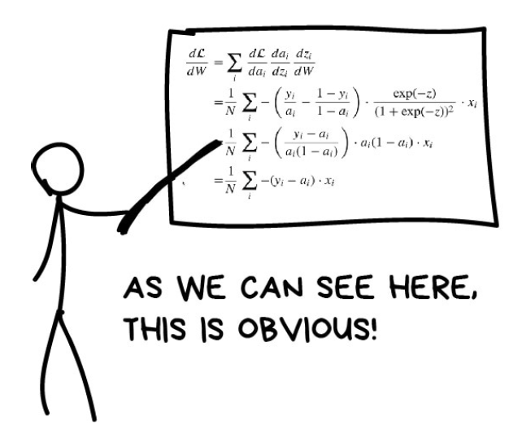
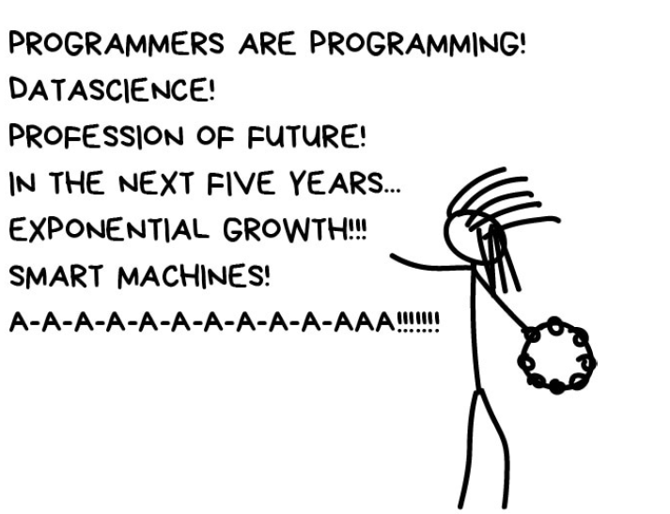

Talking about Machine Learning

Slide 3
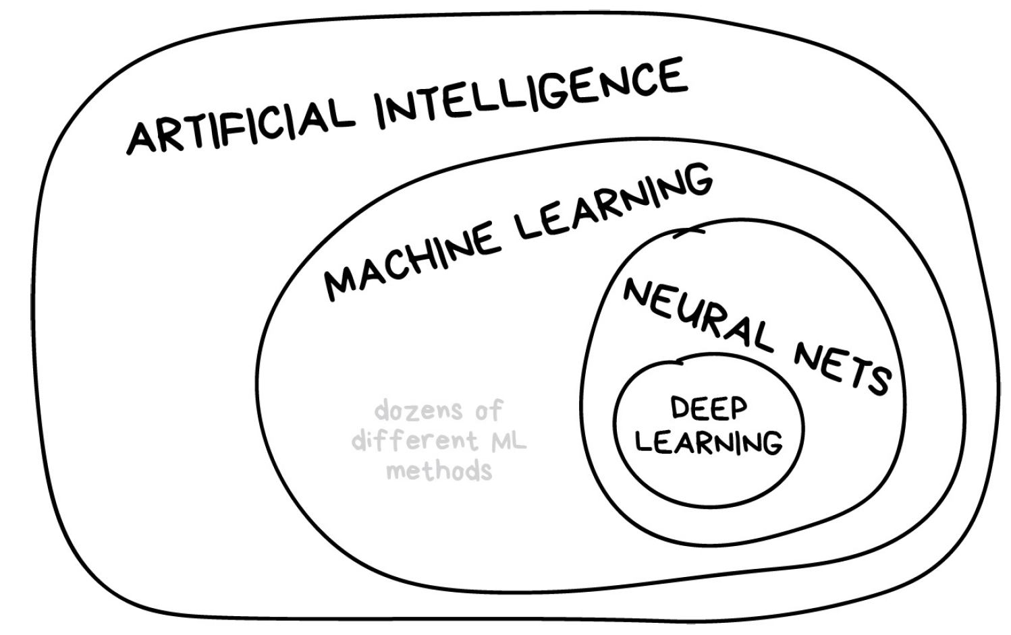
AI? ML? NN? DL?

Slide 4
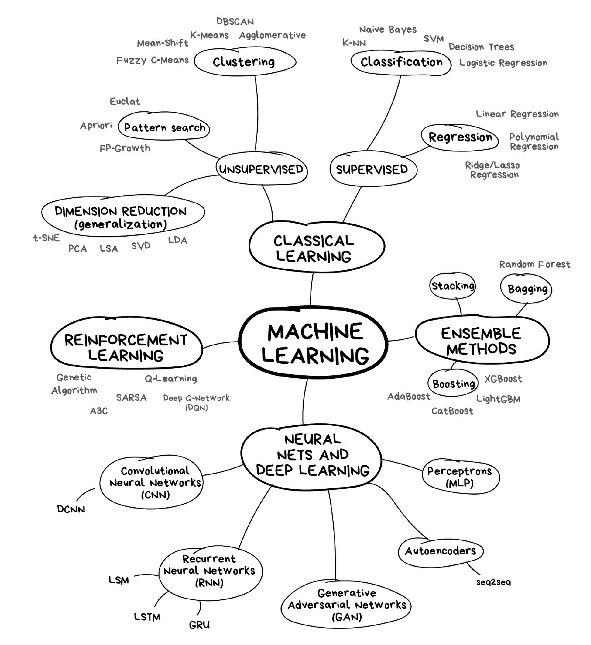
Breakdown of Machine Learning

Slide 5
Supervised Learning
In this ML model, our system learns under the supervision of a teacher.
The model has both a known input and output used for training. The teacher knows the output during the training process and trains the model to reduce the error in prediction.
The two major types of supervised learning methods are Classification and Regression.

Slide 6
Classification
Classification is the mapping of an input to a discrete or categorical output.
Example: Will this customer become a high-value customer?

Slide 7
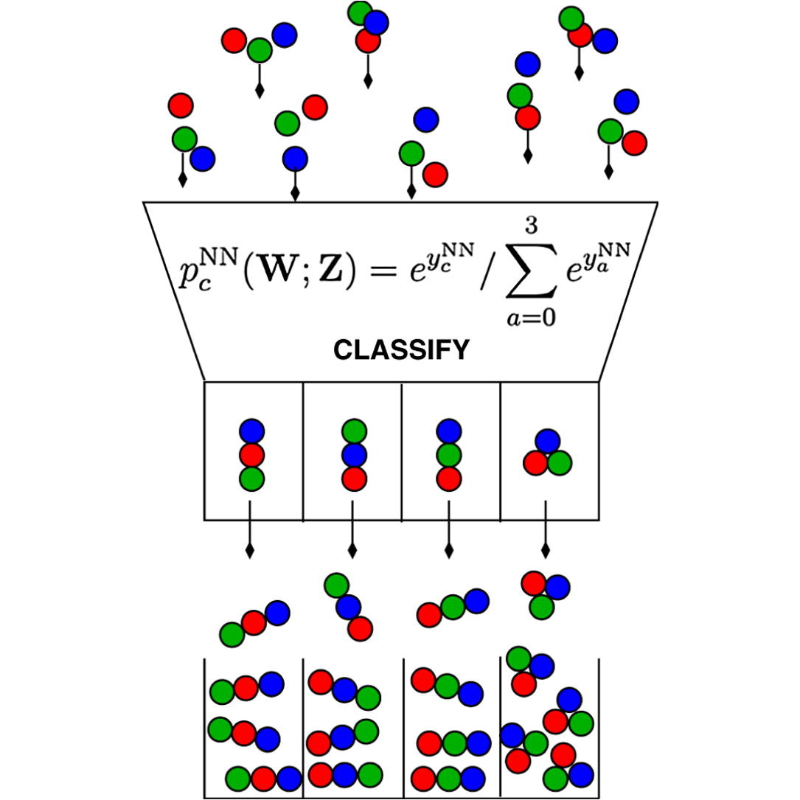
Logistic Regression
Classification Predict observations to a discrete set of classes

Slide 8

Mathematical
Based on a linear relationship between the features z = β₀ + β₁x₁+ β₂x₂+……..+ β_{n}x_{n}
Uses the Sigmoid function to convert the response z into a probability

Slide 9
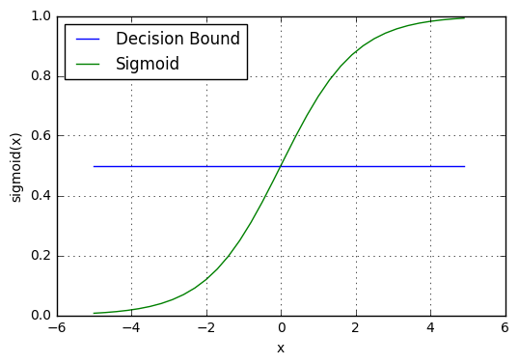
Mathematical
The Sigmoid function returns a probability between 0 and 1
For using this for classification a decision boundary is used
p ≥ 0.5 => class = 1
p < 0.5 => class = 0

Slide 10
Types
Binary Logistic Regression In Binary Logistic Regression, the target variable has two possible categories. The common examples of categories are yes or no, good or bad, true or false, spam or no spam and pass or fail.
Multinomial Logistic Regression In Multinomial Logistic Regression, the target variable has three or more categories which are not in any particular order. So, there are three or more nominal categories. The examples include the type of categories of fruits - apple, mango, orange and banana.
Ordinal Logistic Regression In Ordinal Logistic Regression, the target variable has three or more ordinal categories. So, there is intrinsic order involved with the categories. For example, the student performance can be categorized as poor, average, good and excellent.

Slide 11
Assumptions
Logistic Regression model requires the dependent variable to be binary, multinomial or ordinal in nature.
It requires the observations to be independent of each other. So, the observations should not come from repeated measurements. That is, the model should have little or no multicollinearity.
Logistic Regression algorithm requires little or no multicollinearity among the independent variables. It means that the independent variables should not be too highly correlated with each other.
Logistic Regression model assumes linearity of independent variables.
The success of Logistic Regression model depends on the sample sizes. Typically, it requires a large sample size to achieve the high accuracy.

Slide 12
Steps to create a model in Python
Define: What type of model will it be? A regression model? Some other type of model? Some other parameters of the model type are specified too.
Fit: Capture patterns from provided data. This is the heart of modeling.
Predict: Just what it sounds like
Evaluate: Determine how accurate the model's predictions are.

Slide 13
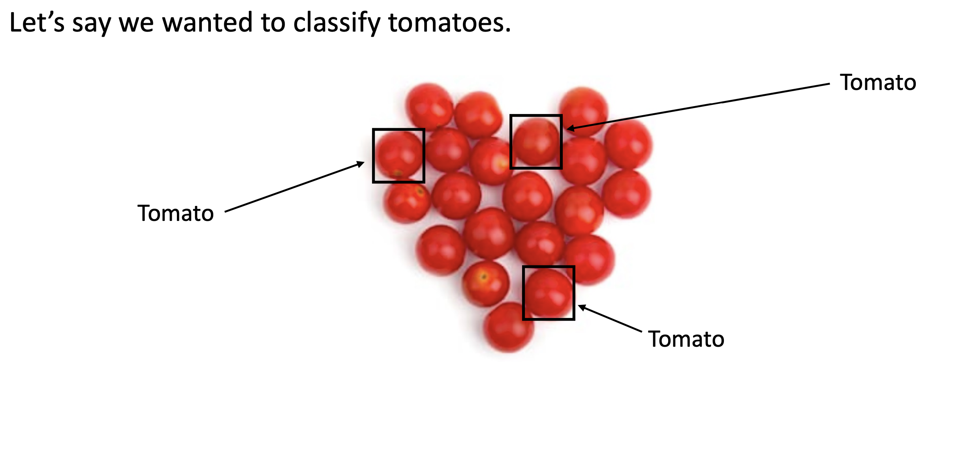
Train-Test Split

Slide 14
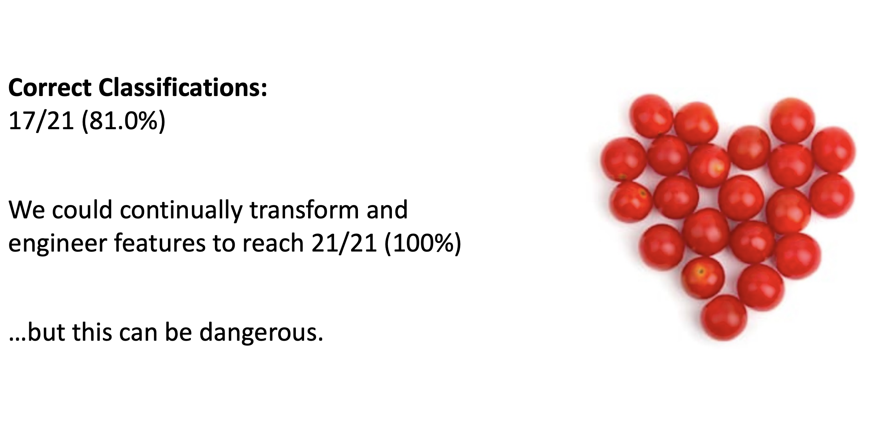
Train-Test Split

Slide 15
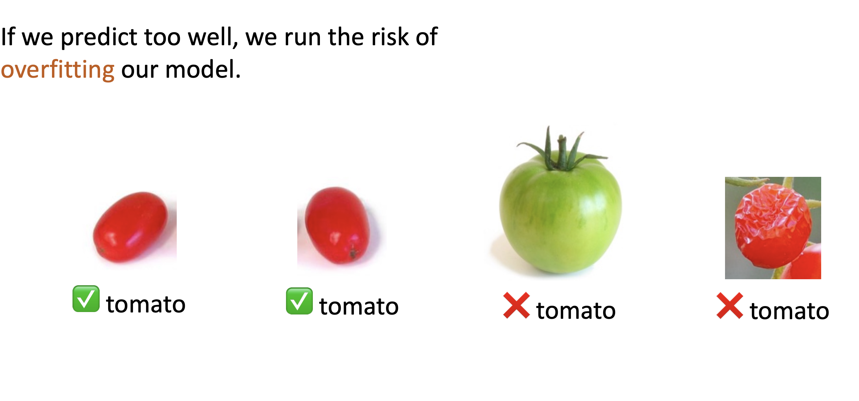
Train-Test Split

Slide 16
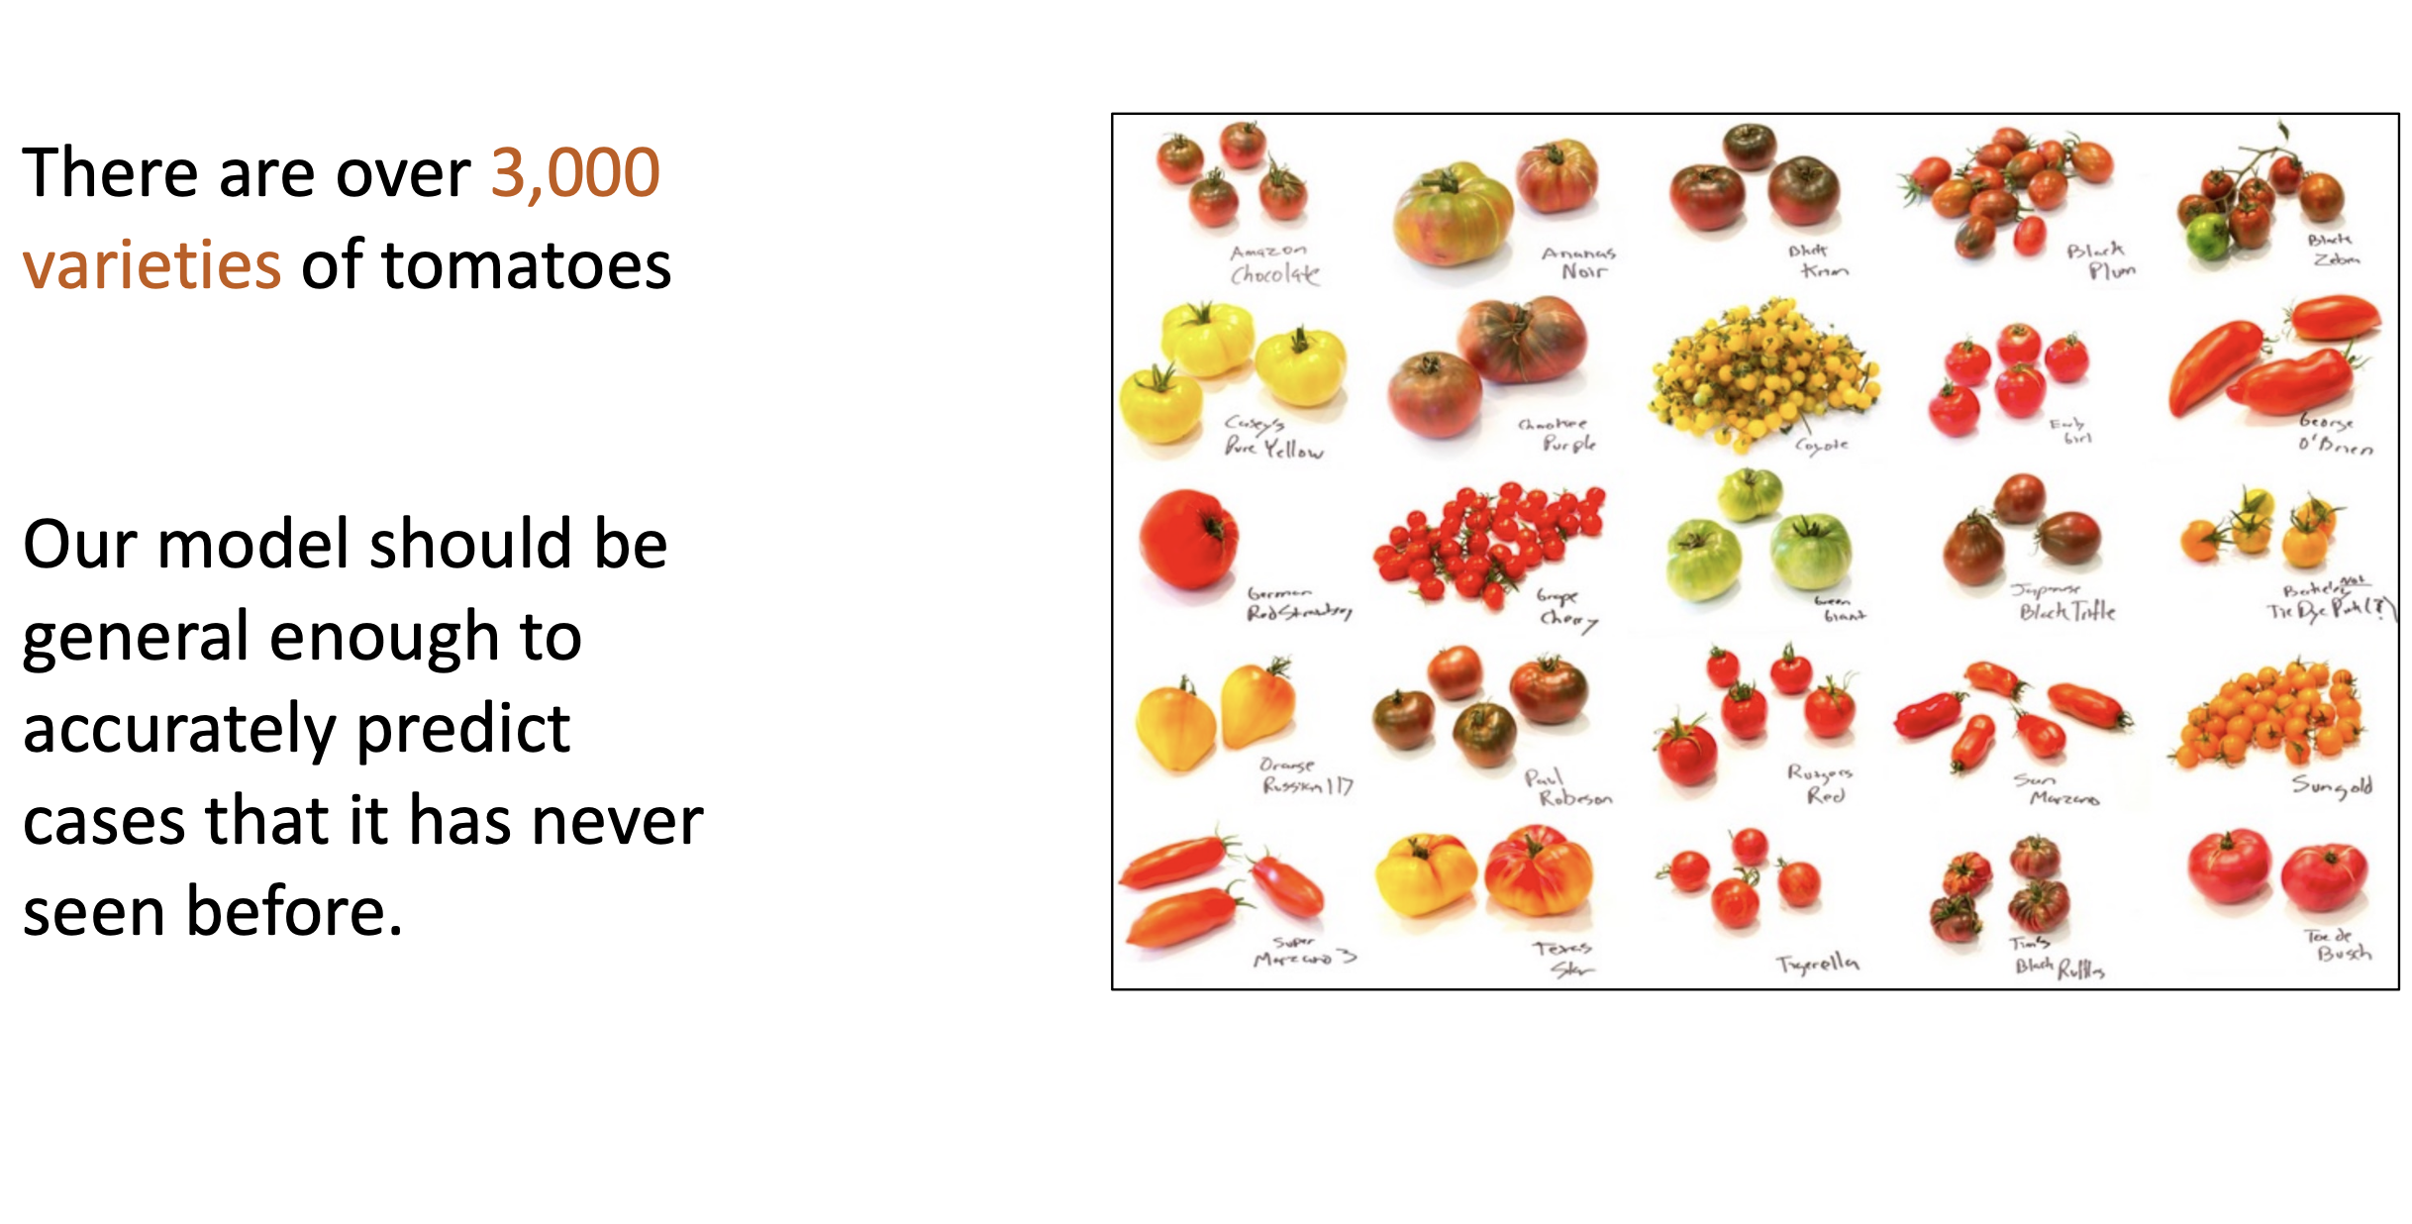
Train-Test Split

Slide 17
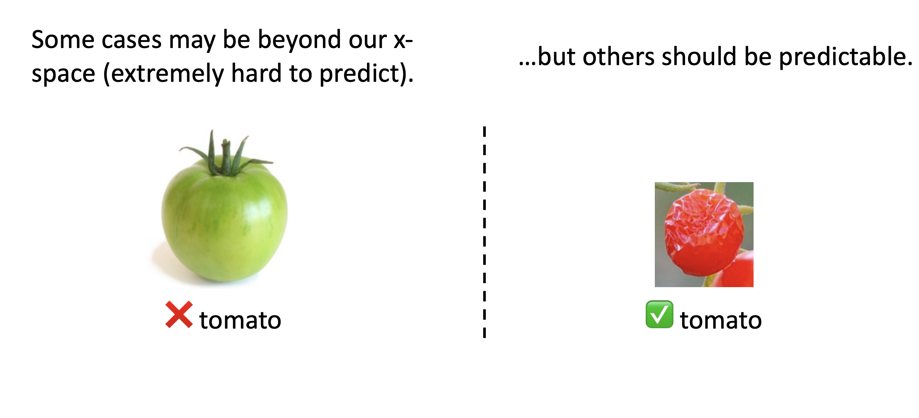
Train-Test Split

Slide 18
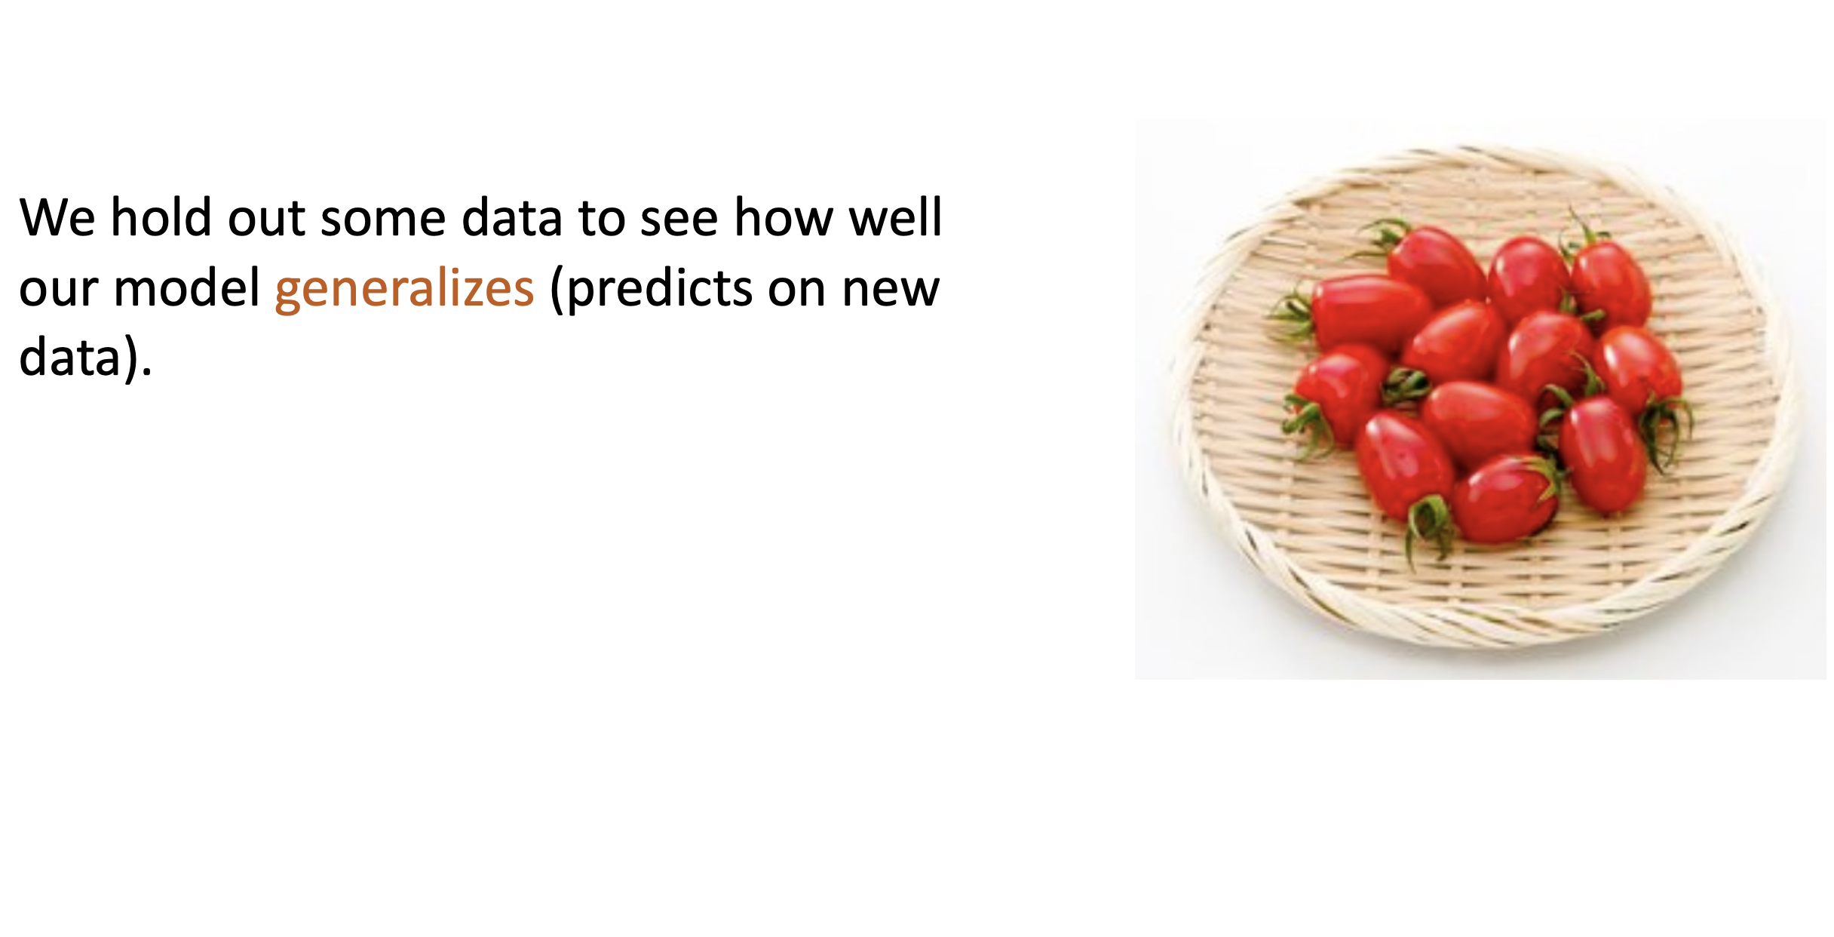
Train-Test Split

Slide 19
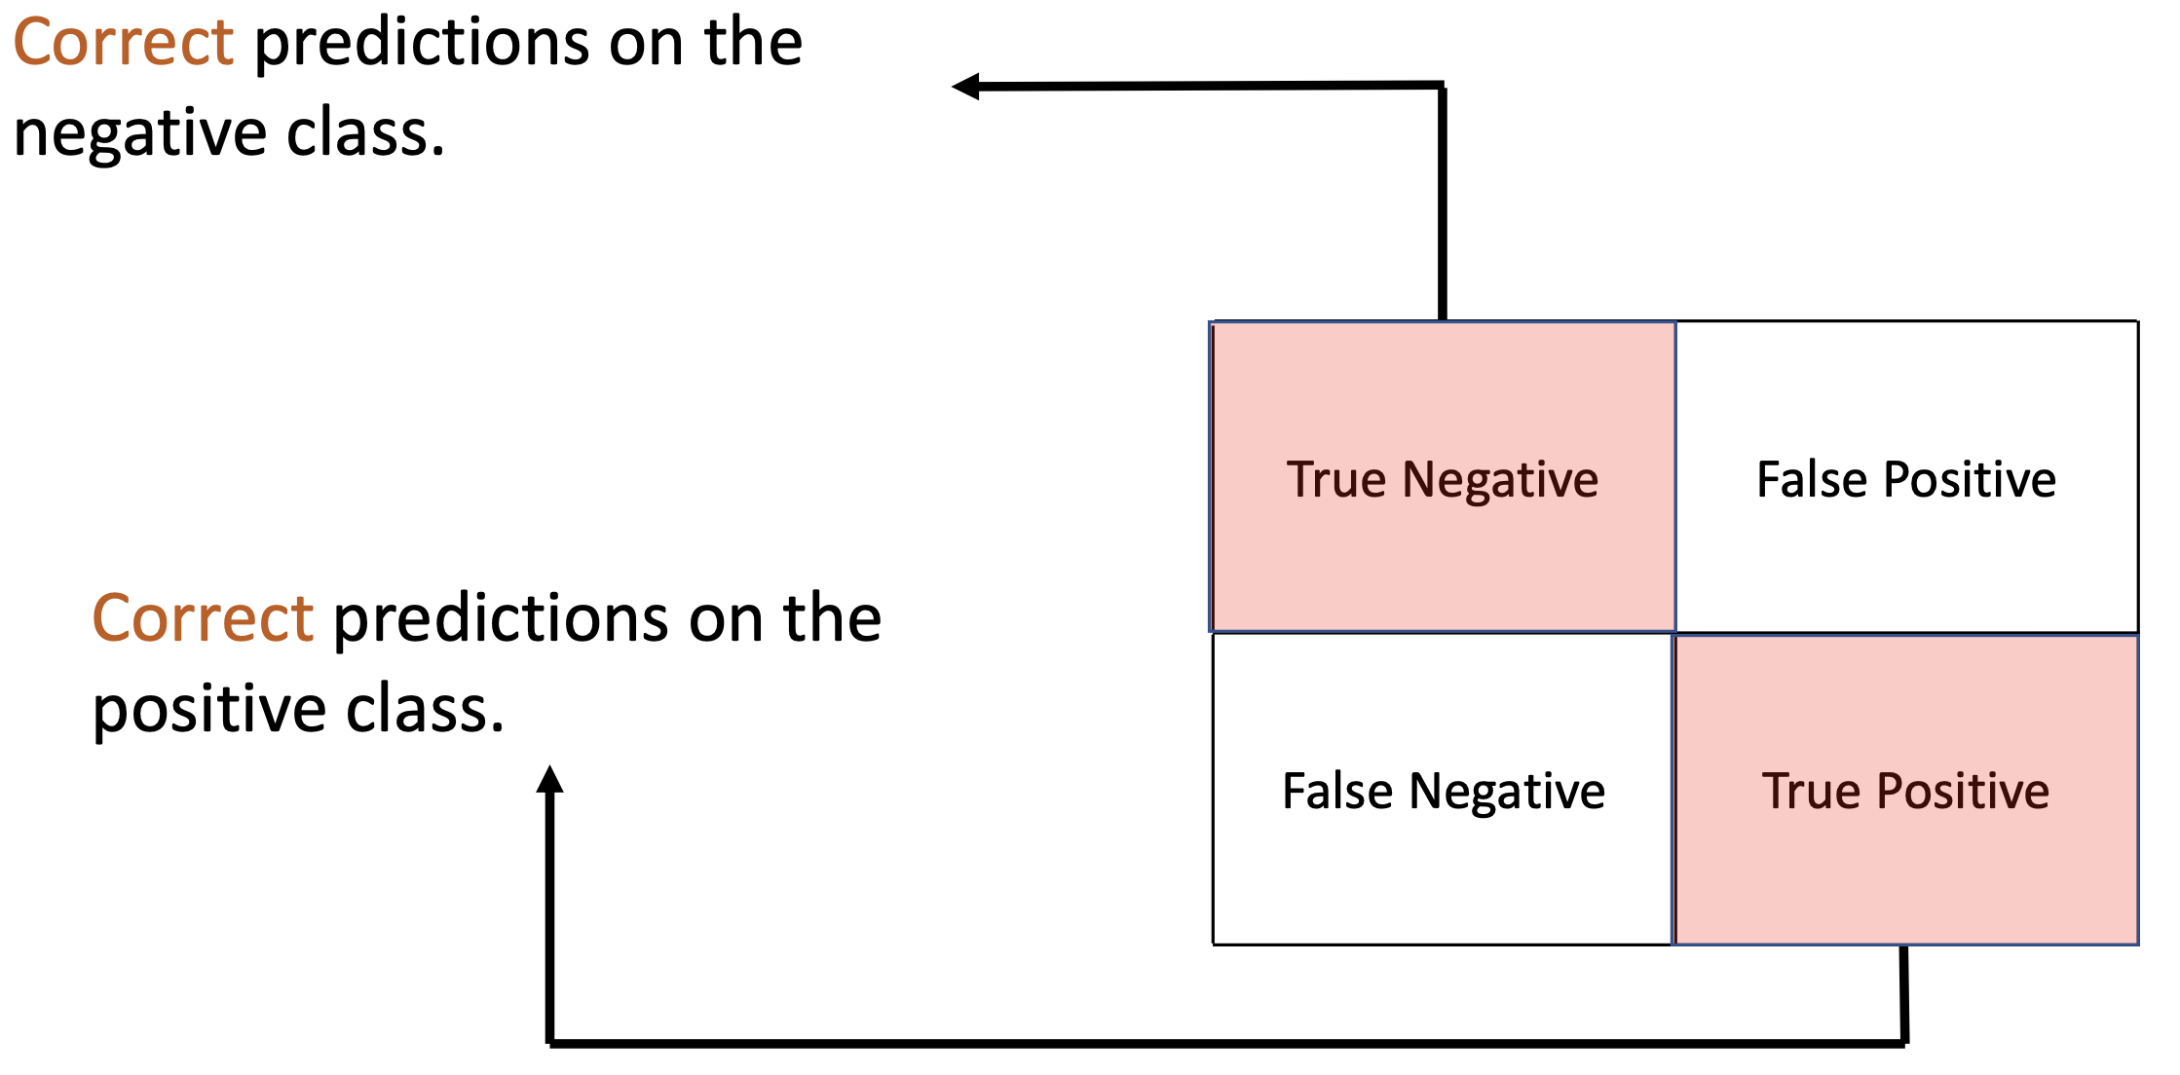
Confusion Matrix

Slide 20
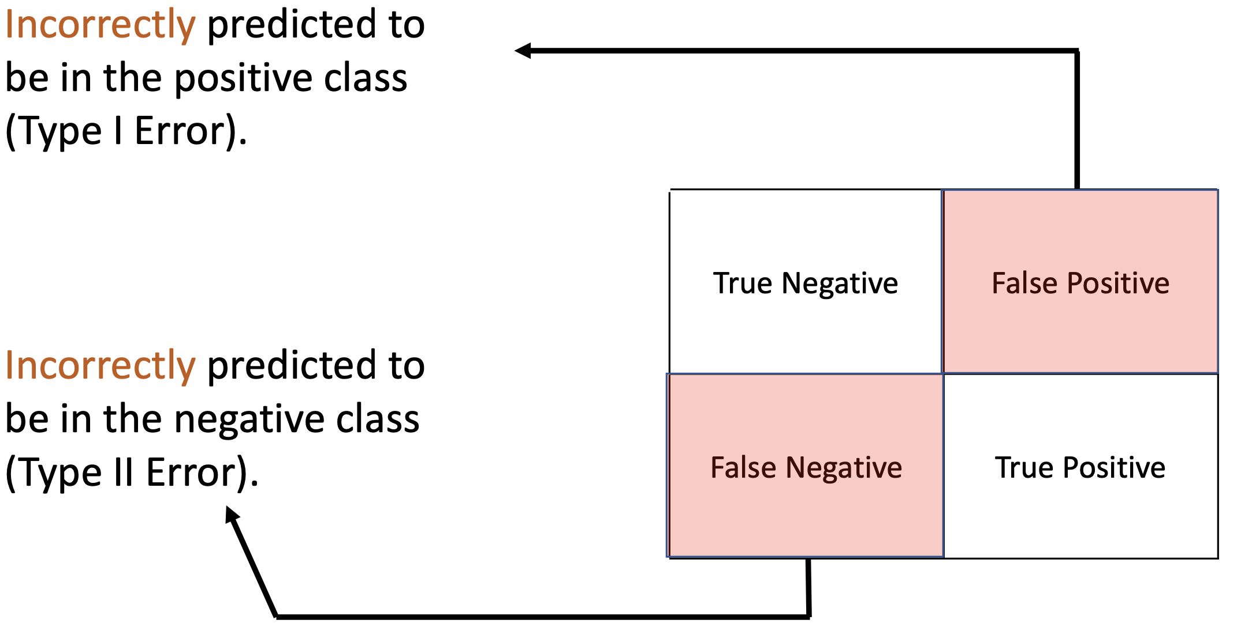
Confusion Matrix

Slide 21
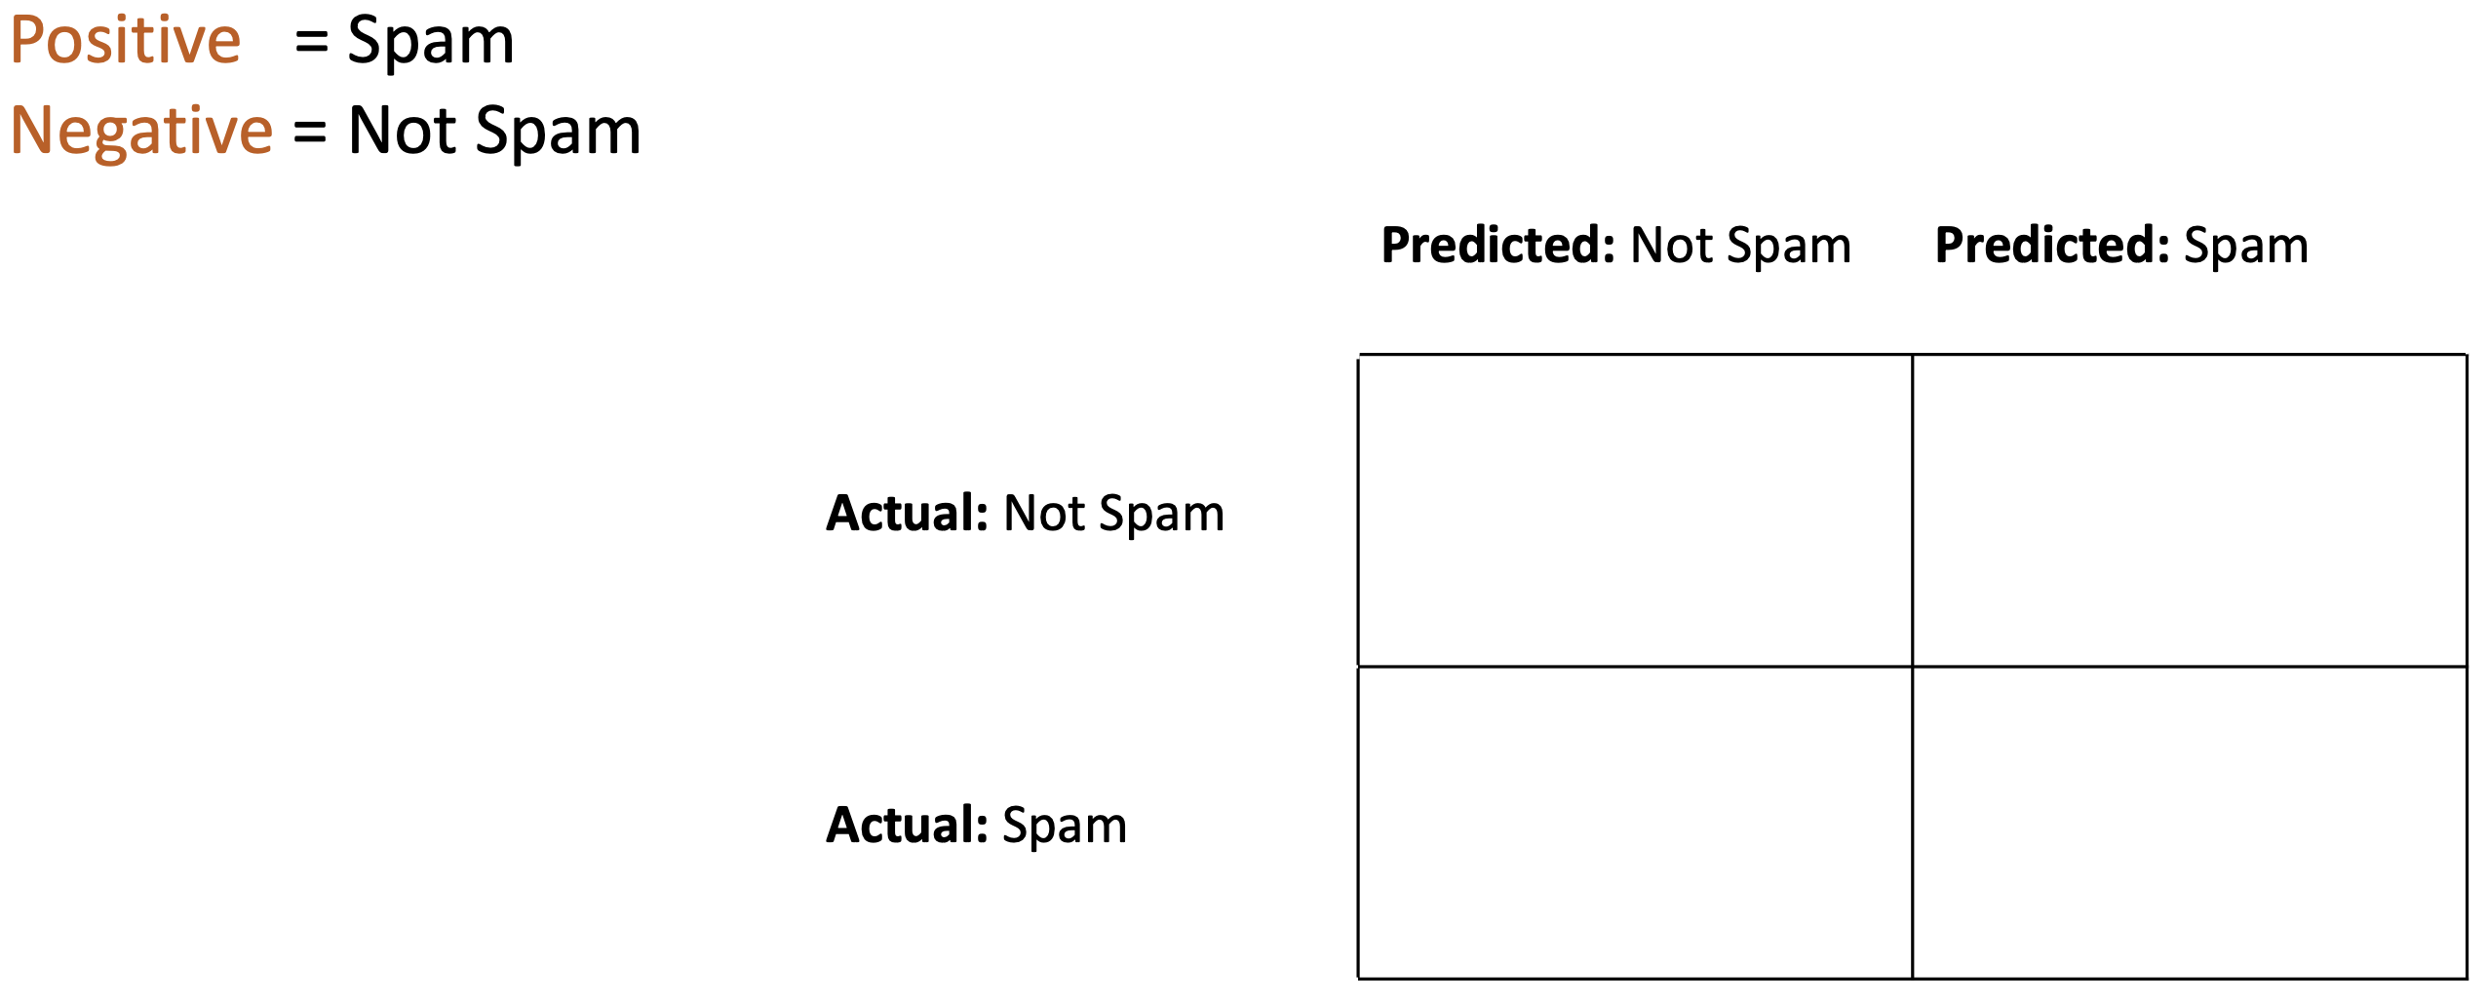
Confusion Matrix – Spam Example

Slide 22
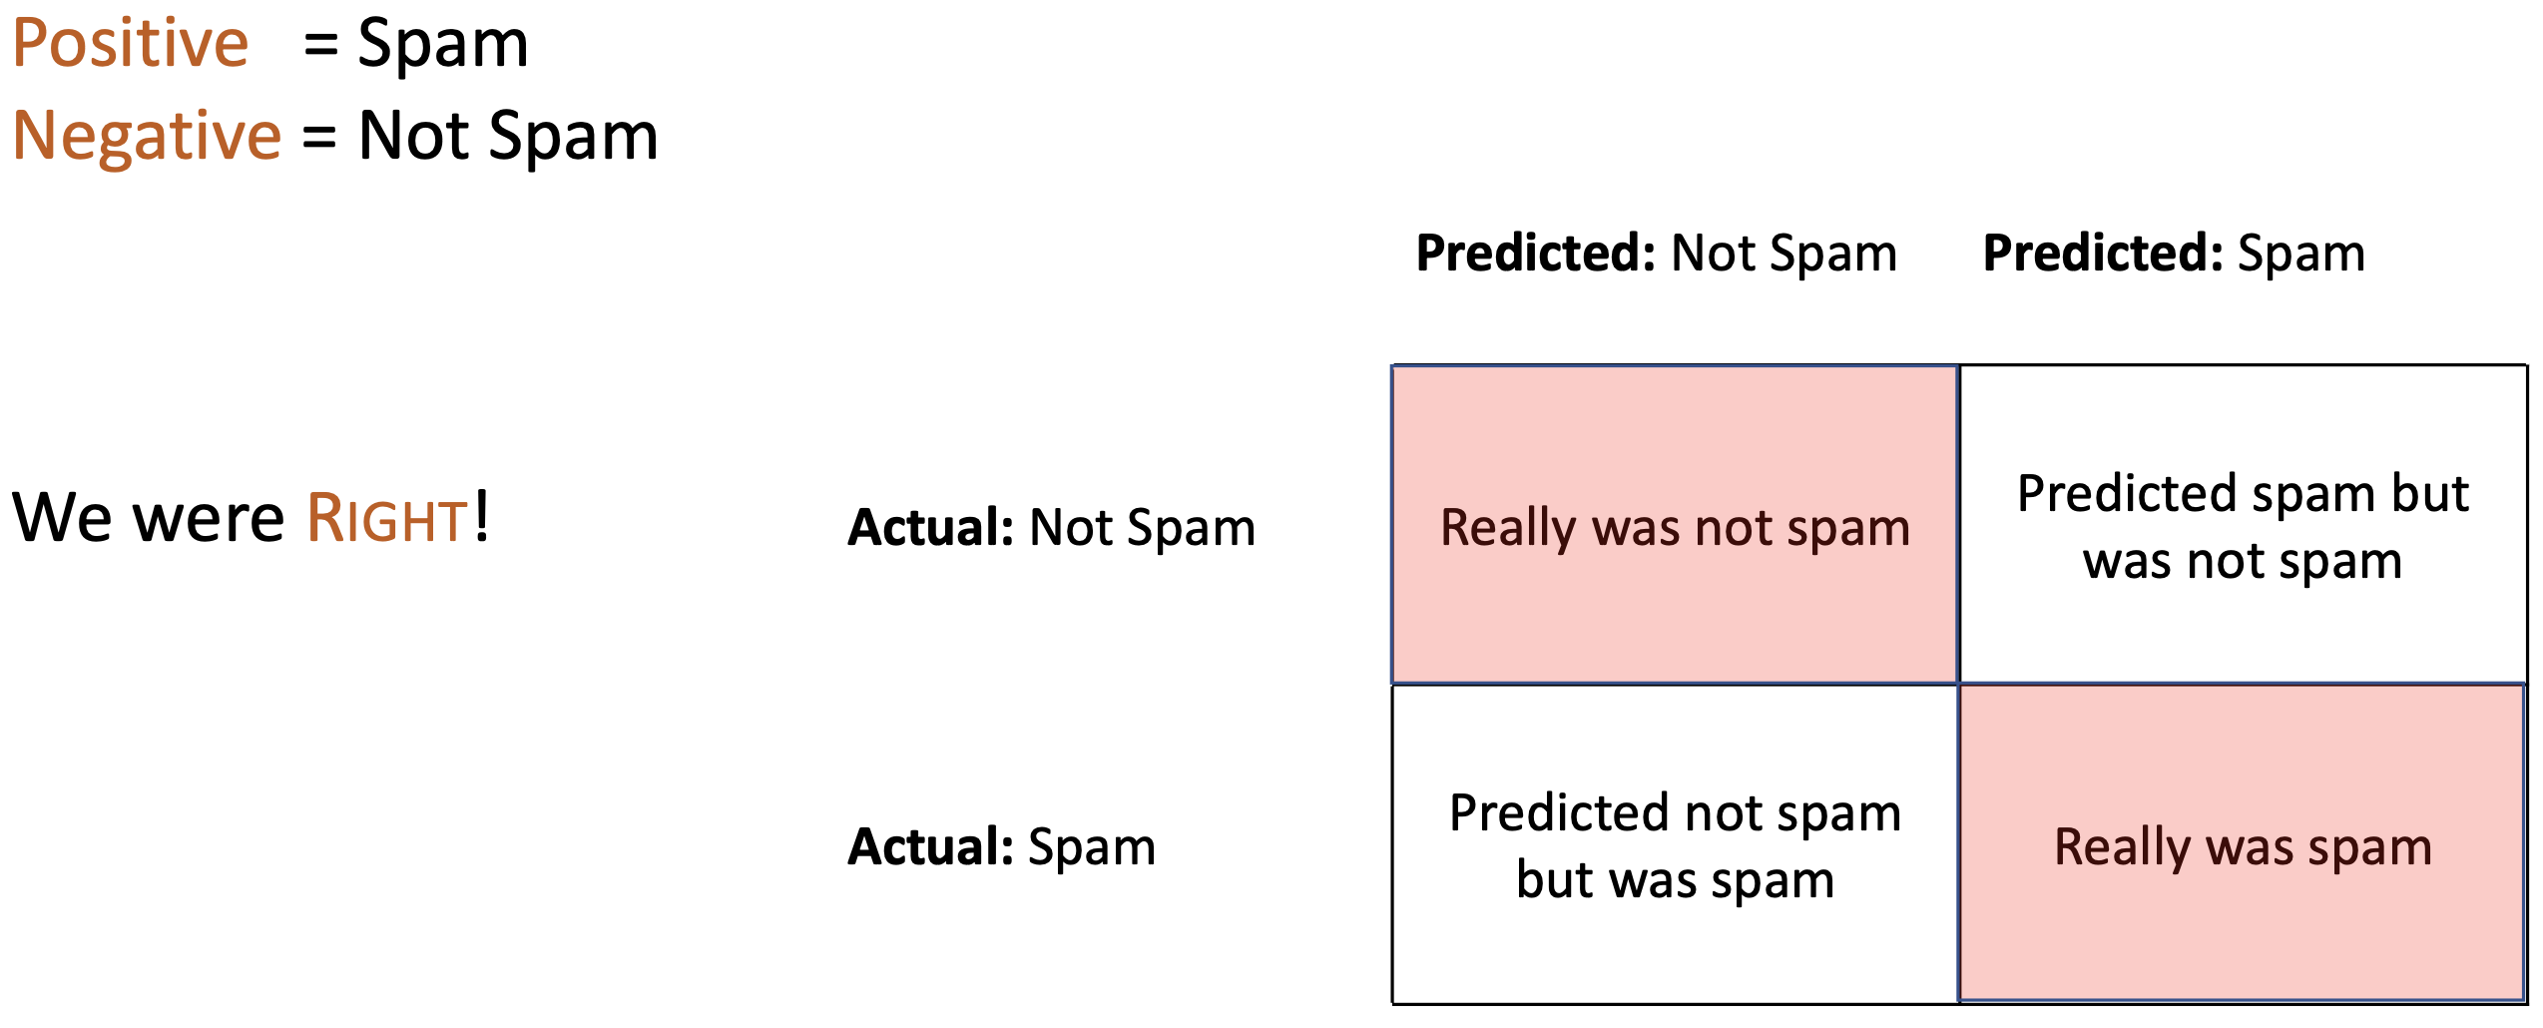
Confusion Matrix – Spam Example

Slide 23
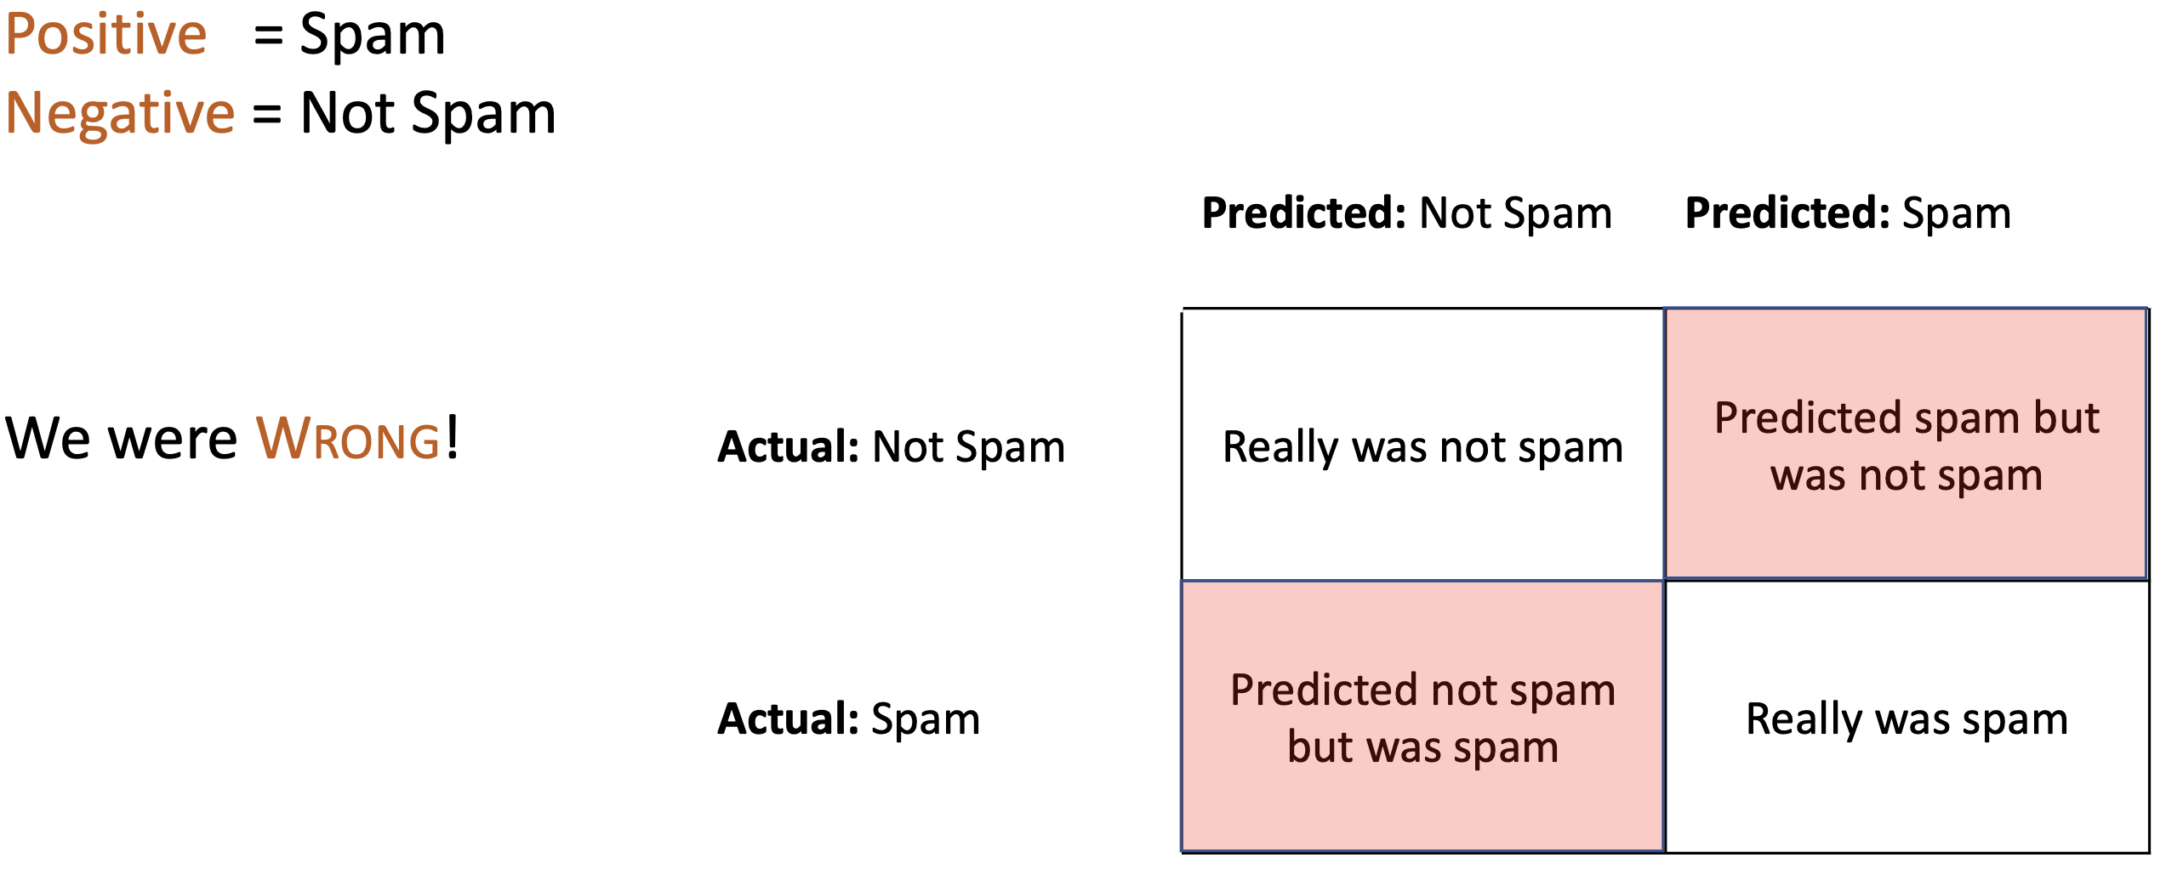
Confusion Matrix – Spam Example

Slide 24
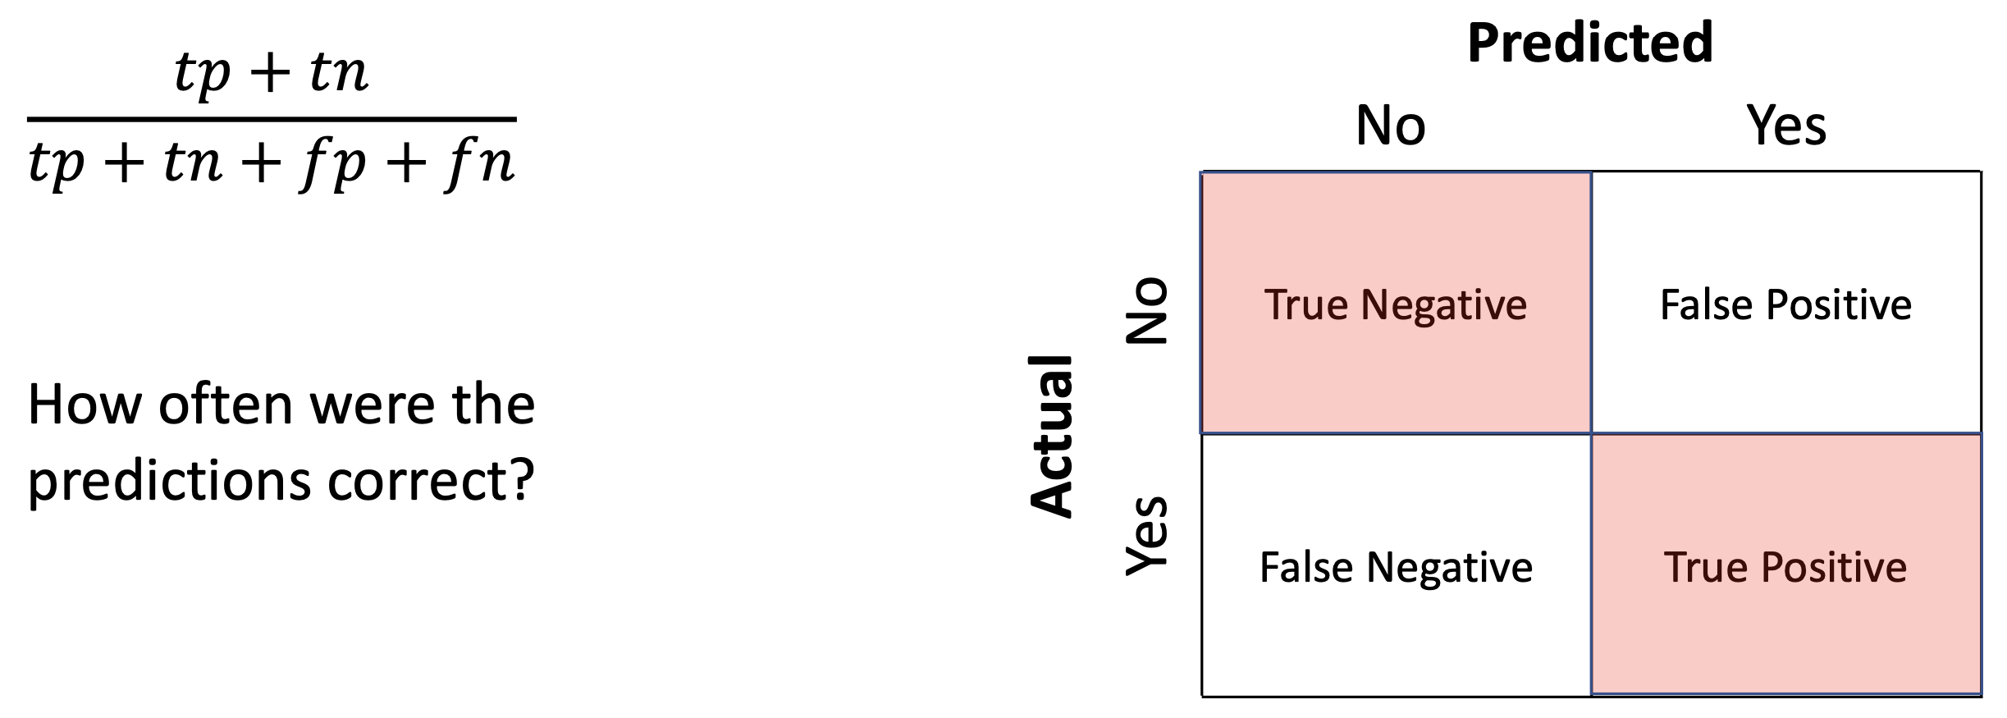
Accuracy

Slide 25
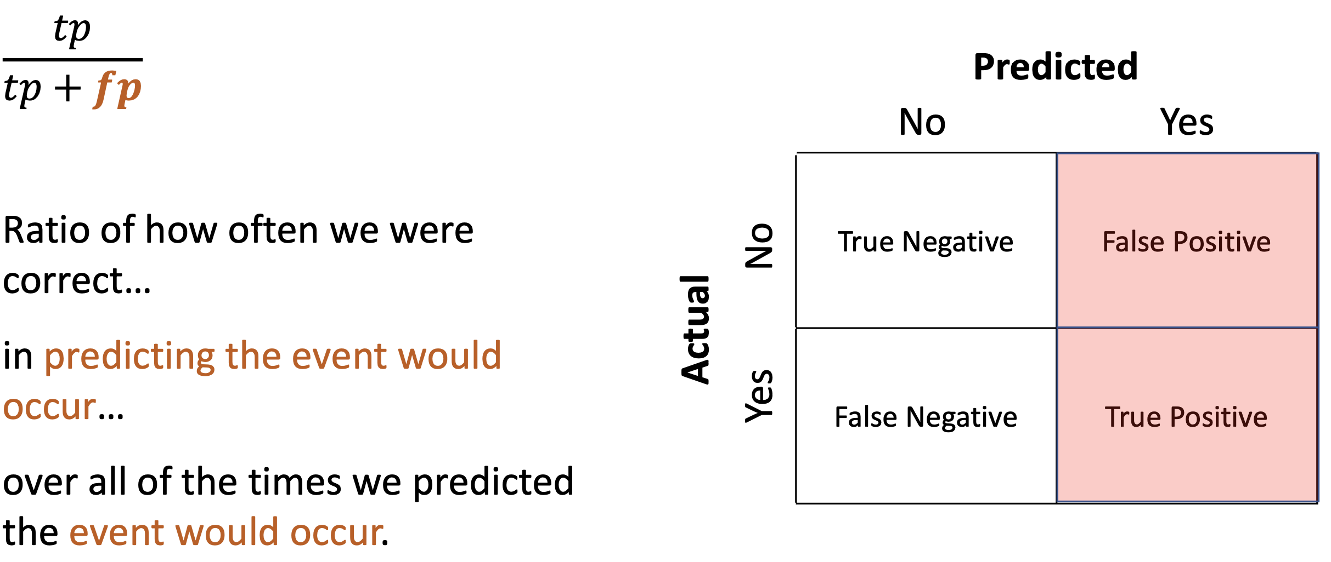
Precision

Slide 26
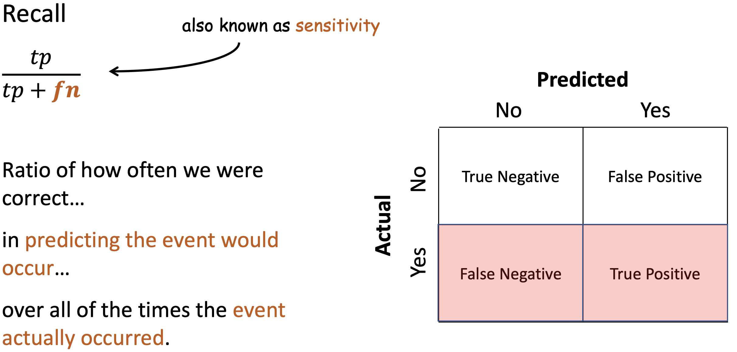
Recall

Slide 27
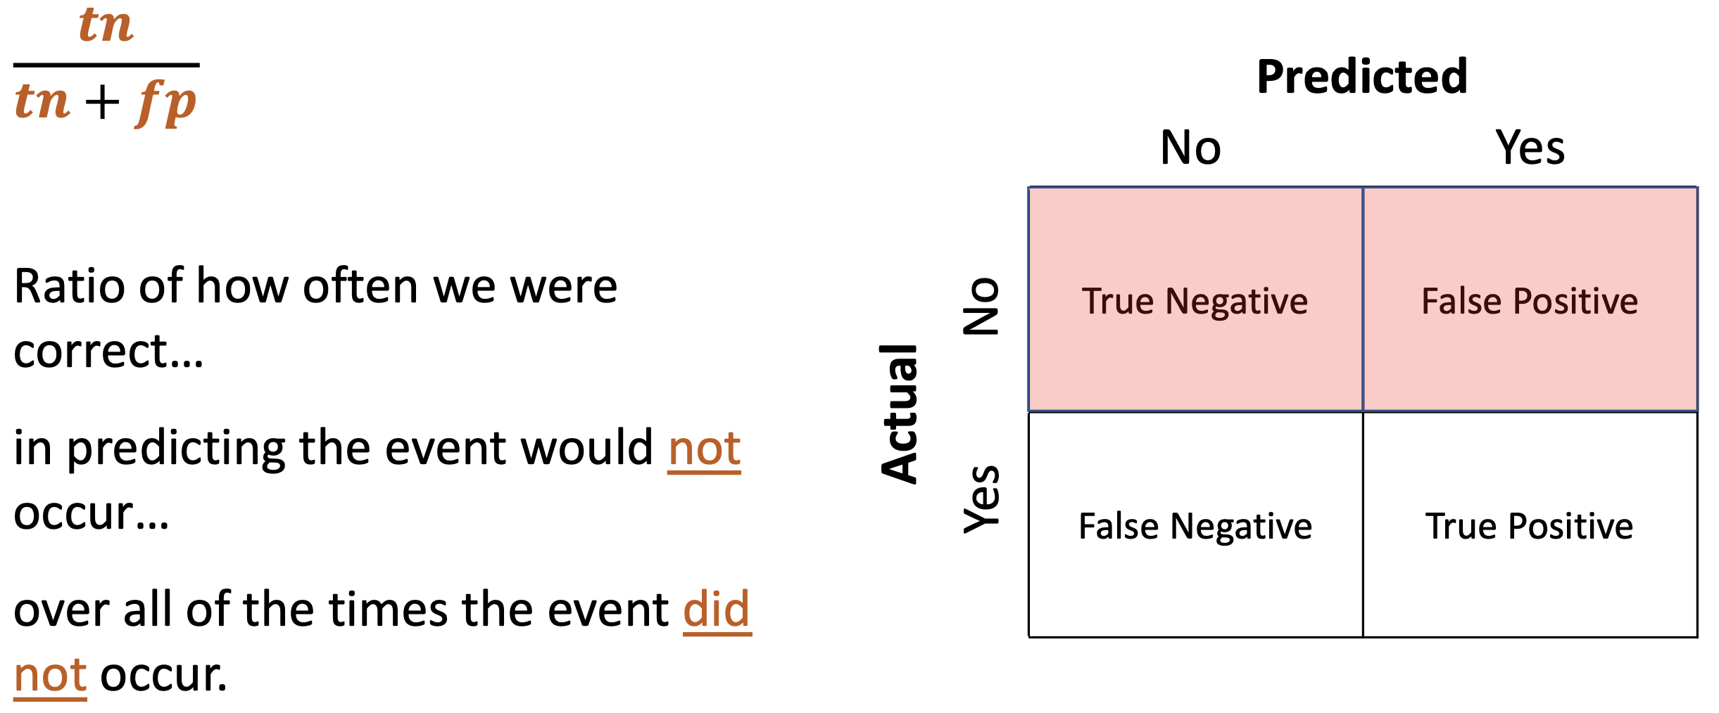
Specificity

Slide 28
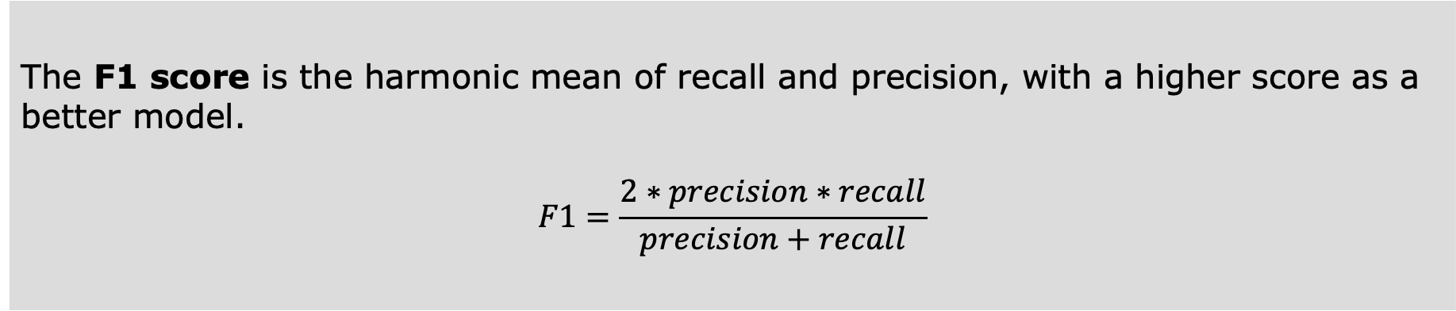
F1 Score
The F1 score is the harmonic mean of recall and precision, with a higher score as a better model.
$$F1=\frac{2∗precision∗recall}{precision+recall}$$

Slide 29
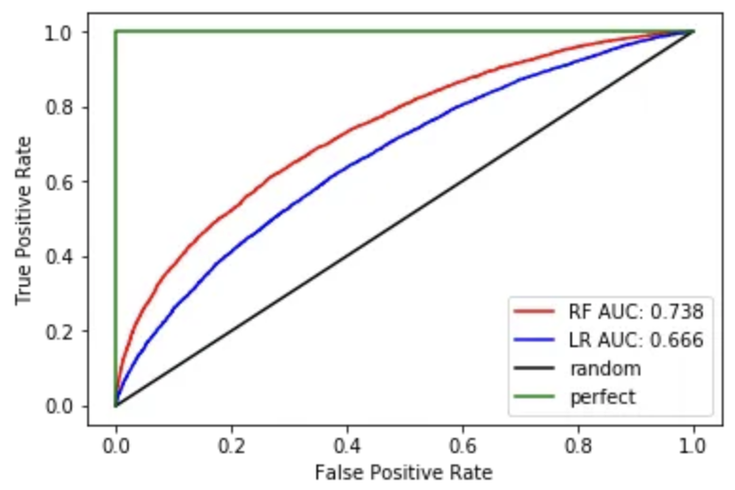
ROC Curve and AUC score
A model that randomly guesses the label will result in the black line
A ROC that is farther away from the black line is better, so RF (red) looks better than LR (blue)
The AUC score is between 0.5 and 1 – the higher the better

Slide 30
Common Classification Models
https://scikit-learn.org/stable/supervised_learning.html
Logarithmic Regression from sklearn.linear_model import LogisticRegression
Lnear Discriminant Analysis from sklearn.discriminant_analysis import LinearDiscriminantAnalysis
K-Nearest Neighbors from sklearn.neighbors import KNeighborsClassifier
Naive Bayes from sklearn.naive_bayes import GaussianNB
Decision Trees from sklearn.tree import DecisionTreeClassifier
Support Vector Machines from sklearn.svm import SVC

Slide 31
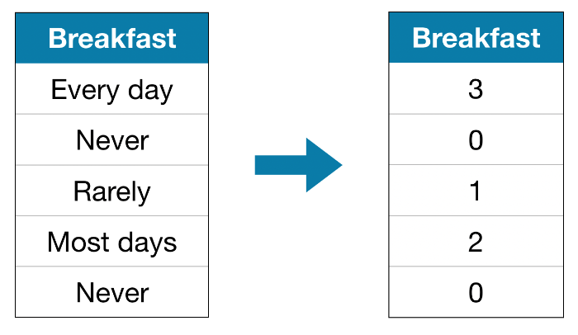
Categorical Data – Ordinal Encoding
Ordinal Encoding assigns assigns each unique value to a different integer.
It assumes an ordering of the categories: "Never" (0) < "Rarely" (1) < "Most days" (2) < "Every day" (3).
This approach usually doesn’t work very well for linear models

Slide 32
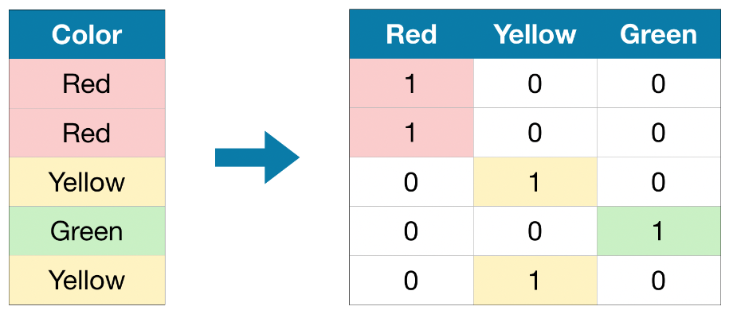
Categorical Data – One-Hot Encoding
One-hot encoding creates new columns indicating the presence (or absence) of each possible value in the original data.
In contrast to ordinal encoding, one-hot encoding does not assume an ordering of the categories.
One-hot encoding generally does not perform well if the categorical variable takes on a large number of values.

Slide 33
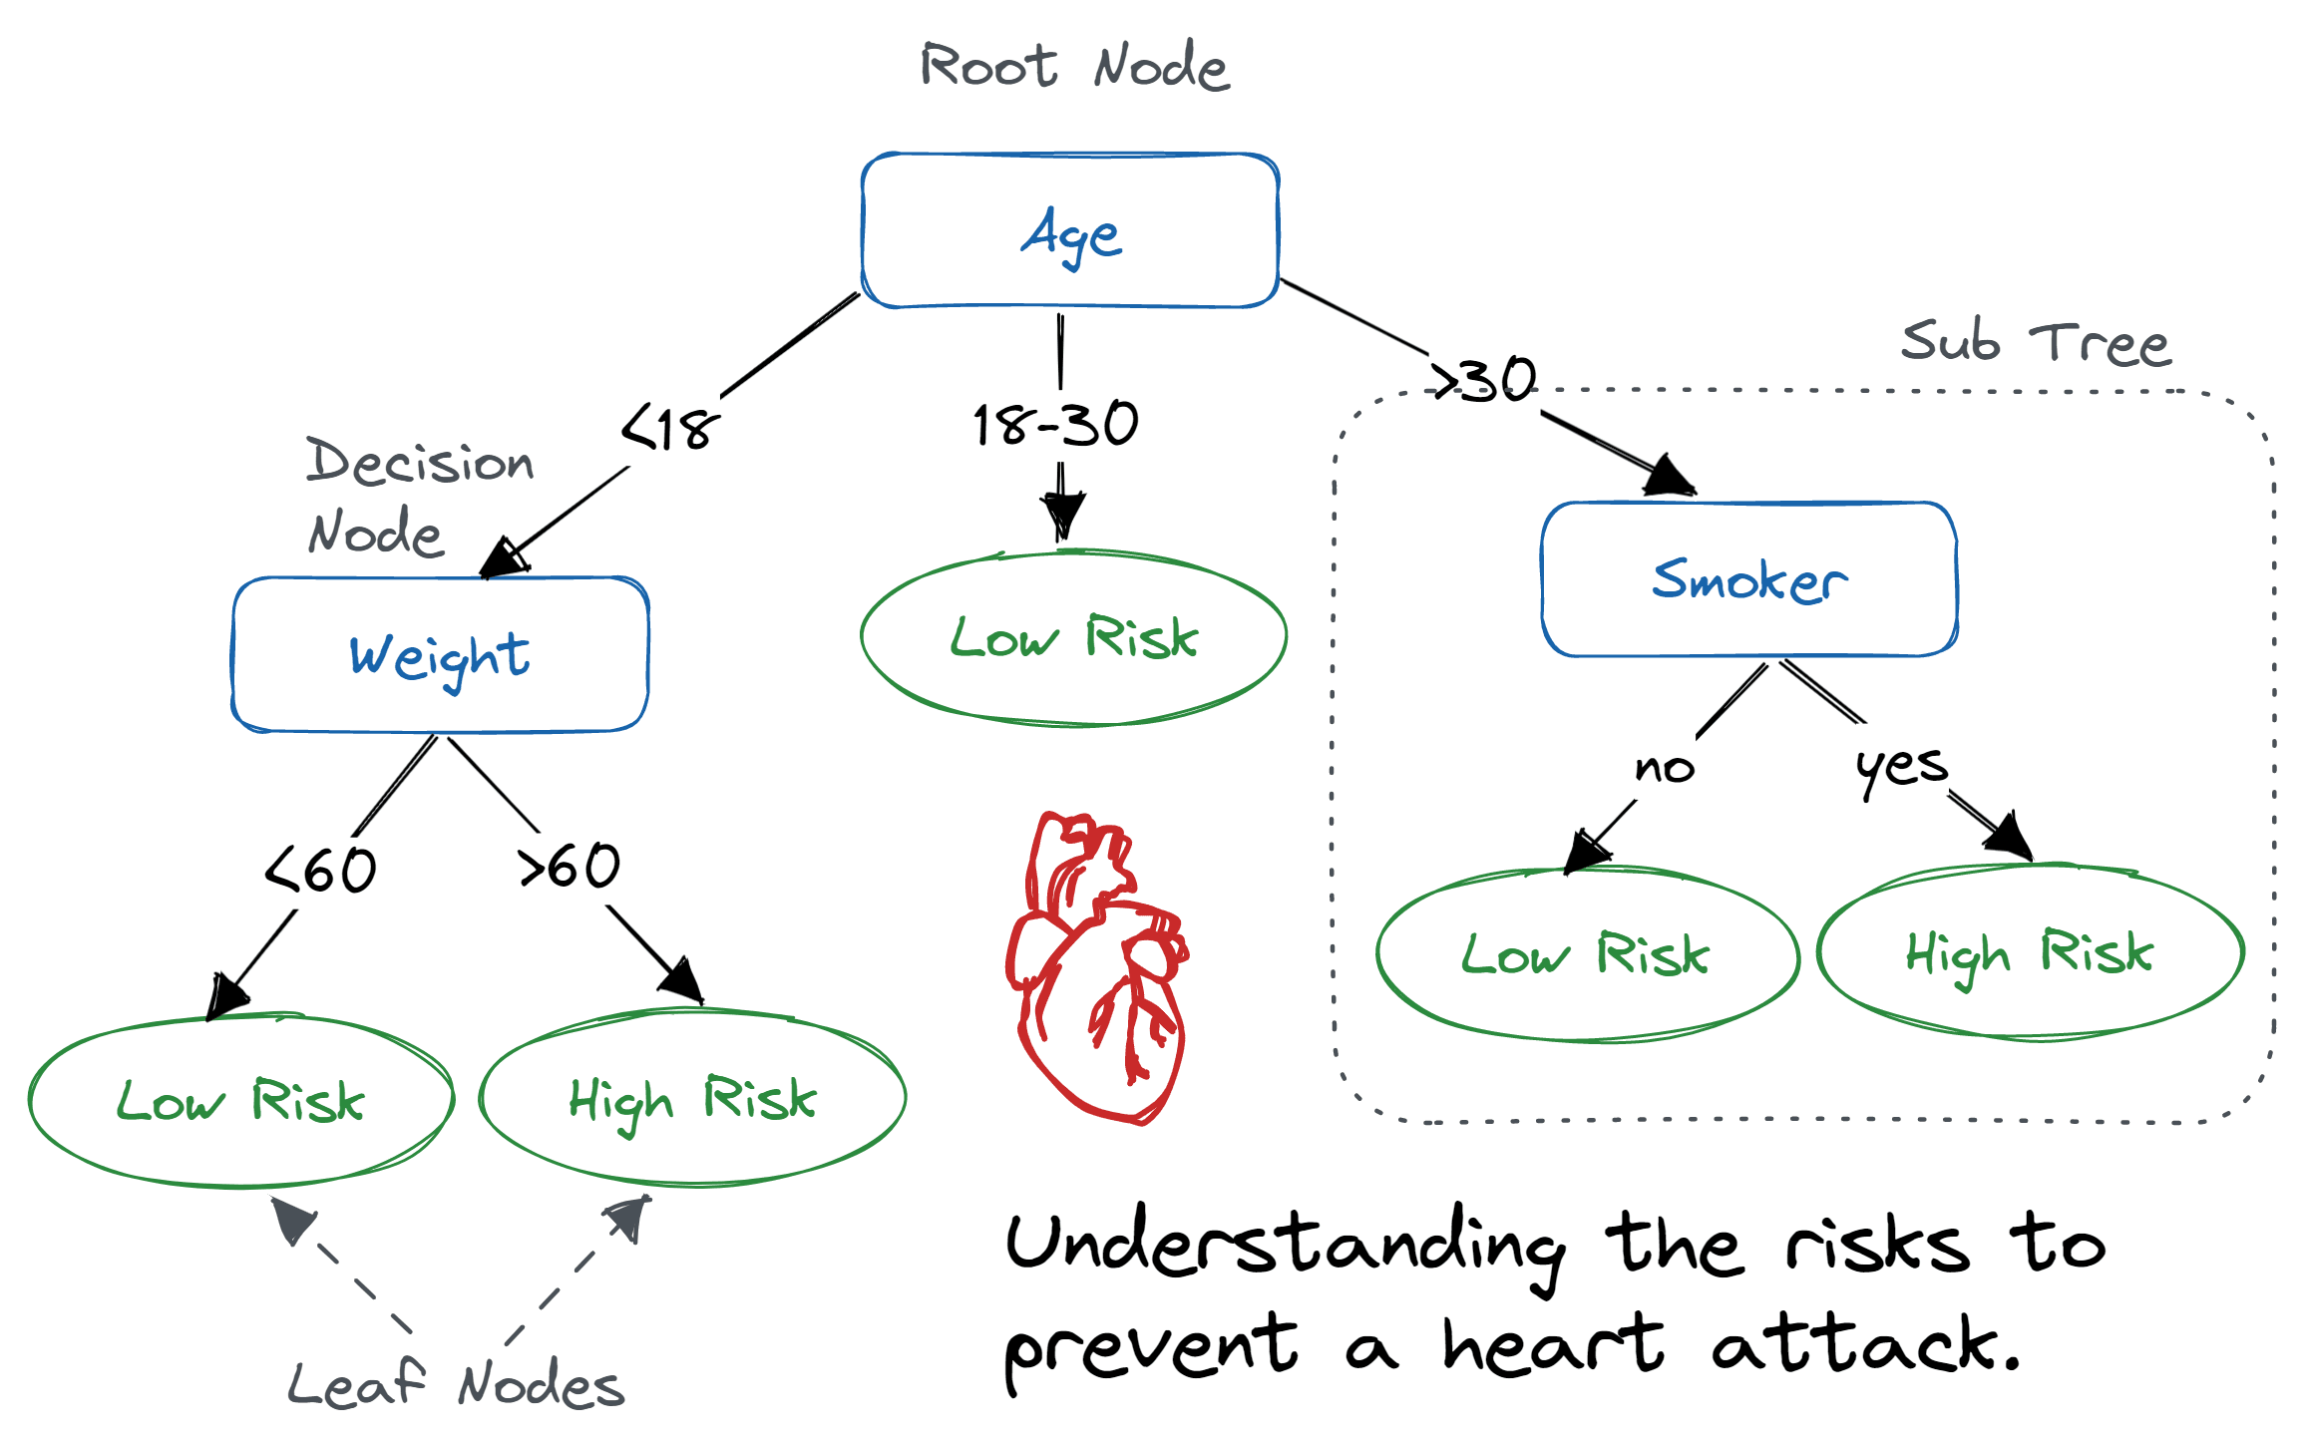
Decision Tree Classifier

Slide 34
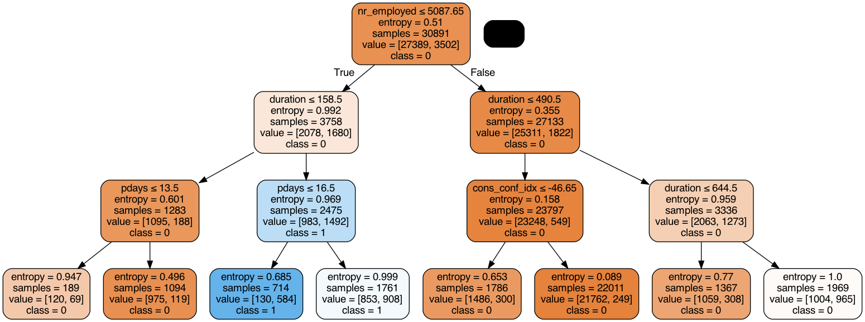
Decision Tree Classifier

Slide 35
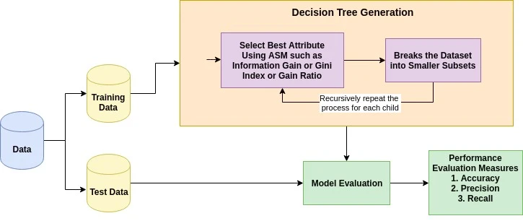
Decision Tree Classifier

Slide 36
Decision Tree Pros/Cons
Pros
Cons
Easy to interpret
Can capture non-linear patterns
No need for normalization
Data distribution doesn’t matter
Sensitive to noisy data
Small variation in data can result in different tree
Imbalanced data creates a biased tree

Slide 37

But how does

